Slide 1
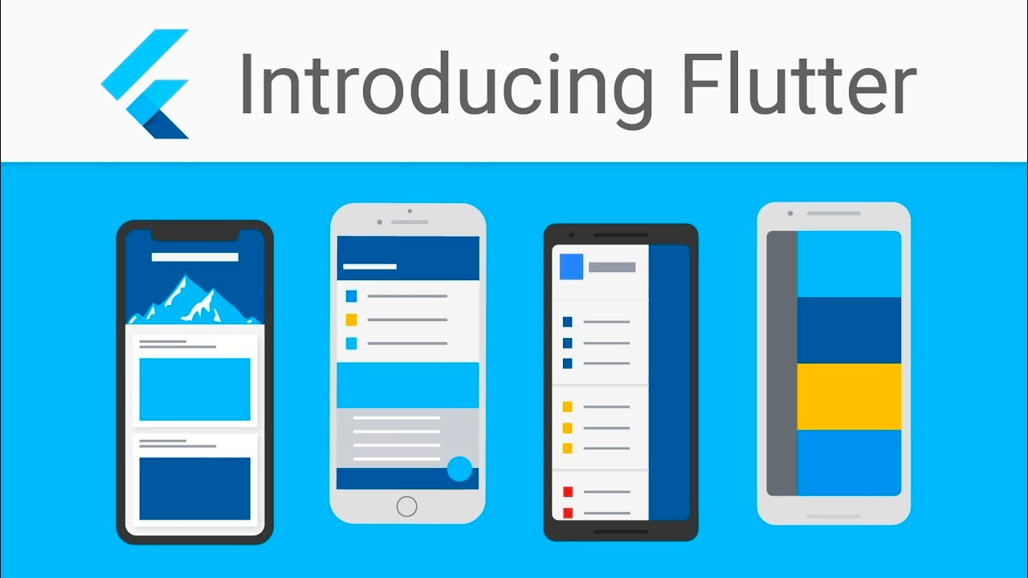

Slide 2
What is included:
Mobile APP Types
What is Flutter?
Why choose Flutter?
Flutter v.s. React Native
Flutter Pros and Cons
MVC / MVP / MVVM
State Management - BLoC
Project structure

Slide 3
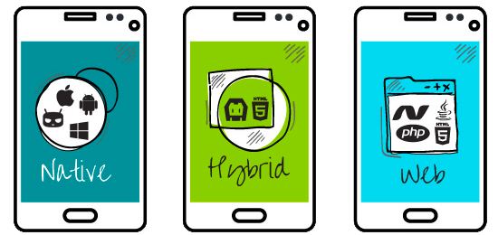
Mobile APP Types
Native APPs
Built specifically for a mobile device’s operating system
Web APPs
Behave similarly to native apps but are accessed via a web browser on mobile device
Hybrid APPs
Web apps that look and feel like native apps
Have a home screen app icon, responsive design, fast performance, even be able to function offline

Slide 4


What is Flutter?
Flutter is Google’s UI toolkit for building beautiful, natively compiled applications for mobile, web, and desktop from a single codebase.
The language used to code in Flutter is Dart, developed by Google, and unique to Flutter, which originally is planned using in Google Chrome.

Slide 5
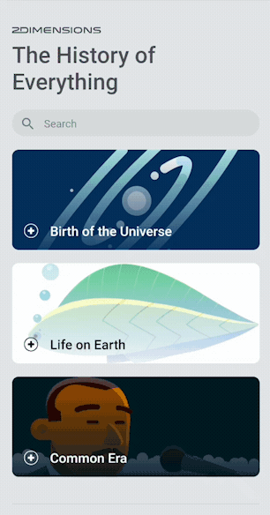
Why choose Flutter?
Fast Development
Stateful Hot Reload
Rich set of fully-customizable widgets
Expressive and Flexible UI
Quickly ship features with a focus on native end-user experiences
Incredibly fast rendering and expressive and flexible designs
Native Performance
Flutter’s widgets incorporate all critical platform differences such as scrolling, navigation
Flutter code is compiled to native ARM machine code using Dart's native compilers

Slide 6
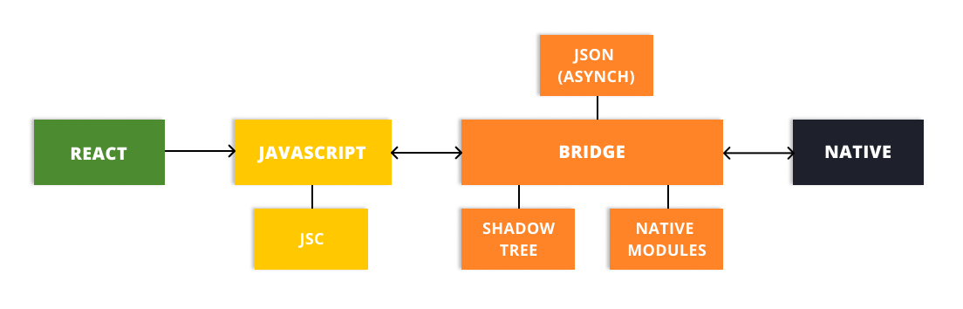
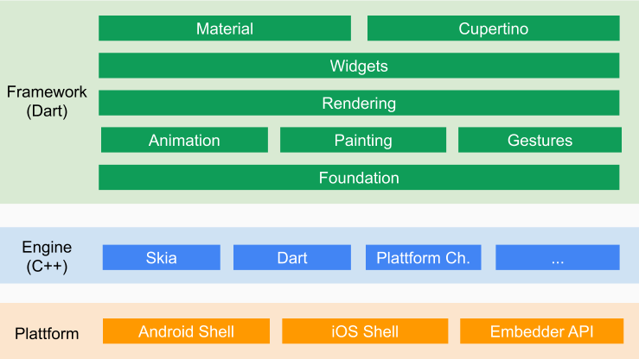
Flutter v.s. React Native - Compilation
React Native
Convert JS to Native Code
VS
Flutter
Draw whatever you want with C++ based Graphics Engine

Slide 7
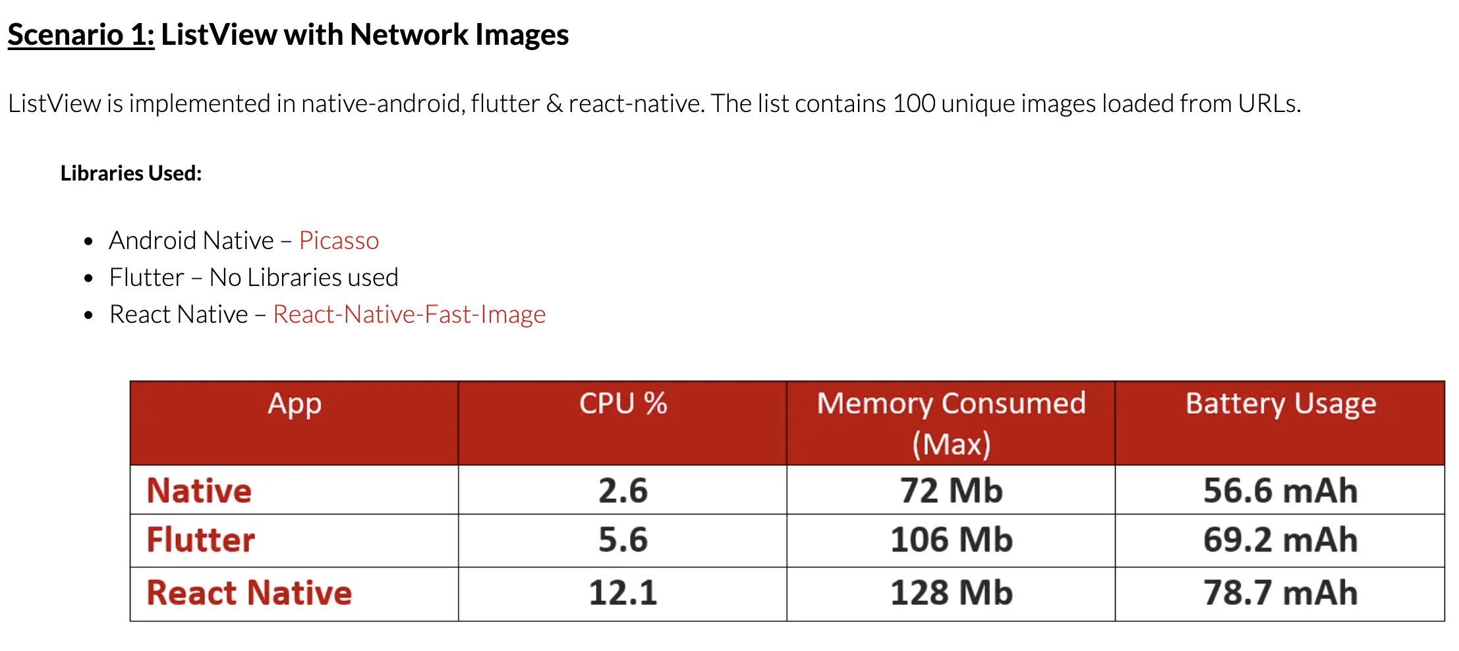
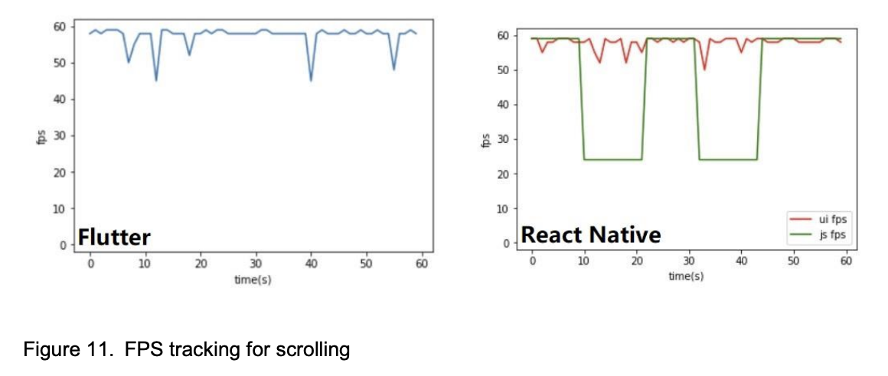
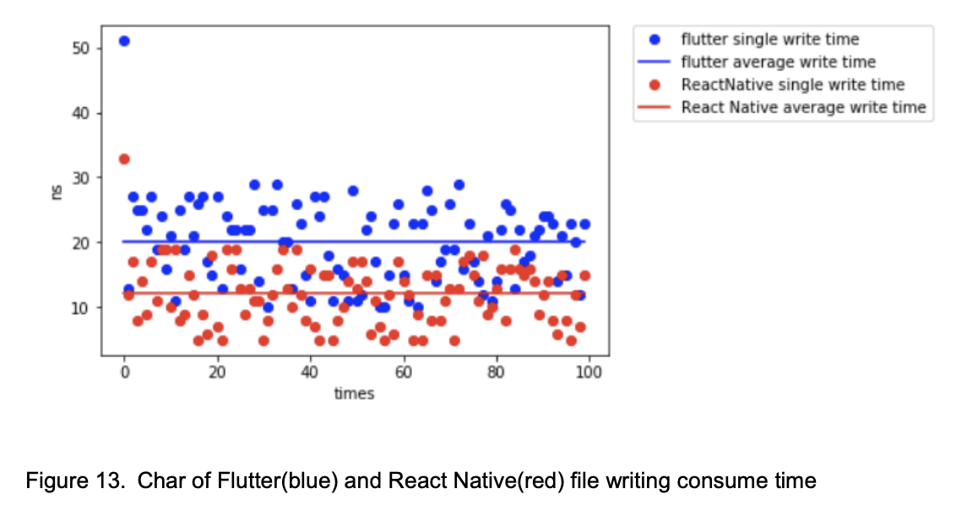
Flutter v.s. React Native - Performance
Flutter and React Native are similar frameworks for developing a cross-platform mobile APP
Studies show there are strengths and weaknesses between these two frameworks.
React Native perform better in Disk I/O
Flutter perform better in UI interactive
As trading system required a fast UI for price quoting, Flutter seems is a better choice.

Slide 8


Flutter Pros and Cons
Faster development time - Hot reload
Lower maintenance cost - Same codebase
Synchronise logic between iOS and Android
Higher performance compared with React Native and Web APPs
Less libraries compared with React Native
Less flexibility compared with Native
Latest updates relied on Google Flutter team
Lower performance compared with Native in some cases. However which can be overcome by using native code with Flutter Platform Channel

Slide 9
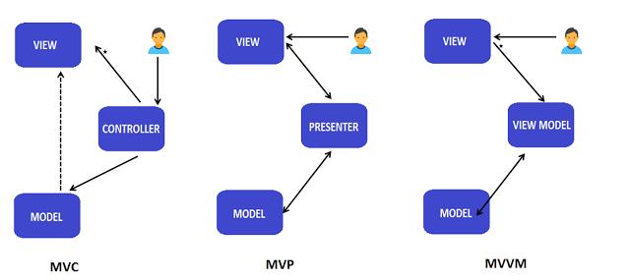


Design Pattern - MVC vs MVP vs MVVM
Notes:
MVC
Oldest / Many implementation ways
Controller entry point
One-Direction-Flow
Easy to implement
Difficult to split business logic with UI
MVP
Derived from MVC
View entry point
Two-Directional-Flow
Use when the UI affected by the updates from Model are very limited
MVVM
View entry point
One or Two-Directional-Flow
View updated by Model frequency
High learning curve

Slide 10
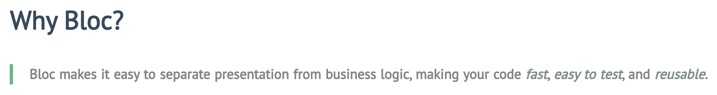
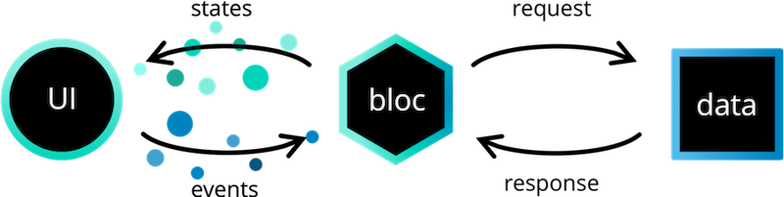
BLoC - Business Logic Components
Most popular State management library for Flutter

Slide 11
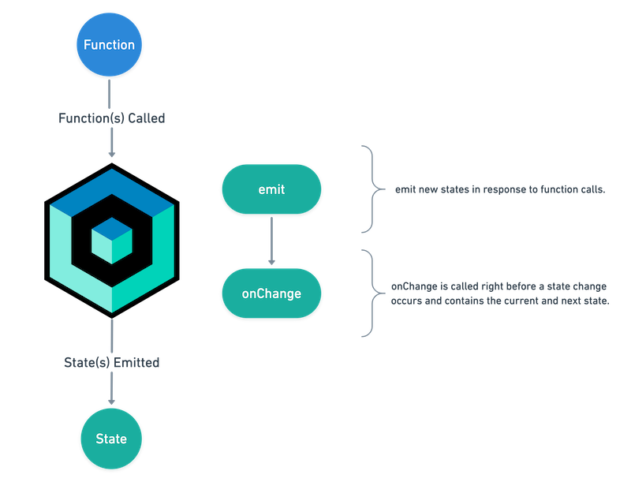
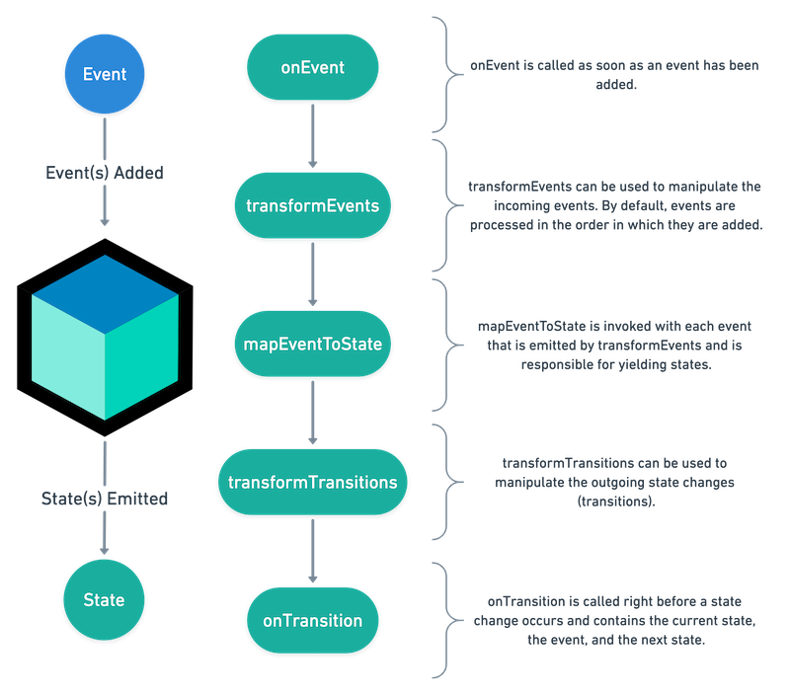
BLoC Cubit - Simplified Lifecycle

Slide 12
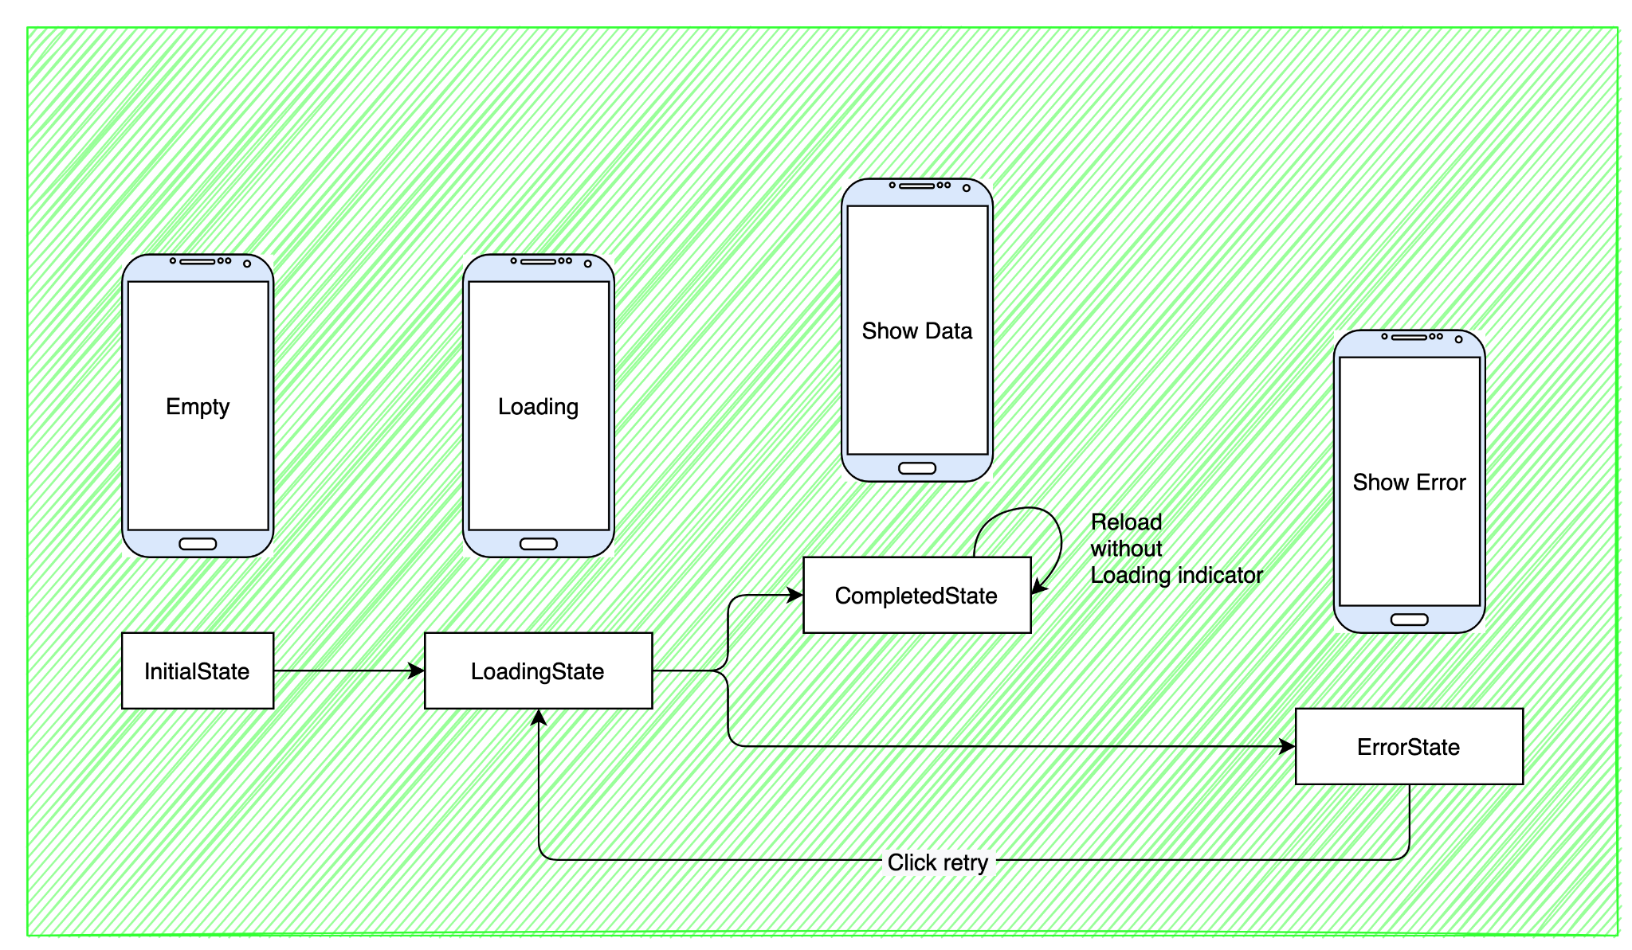
Simple Page BLoC State Definition

Slide 13
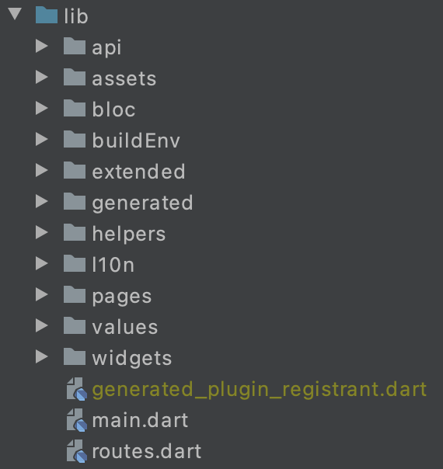
Project Structure
Theme / Locale Handling
Navigation Handling
API Handling
Formatting Handling
BuildEnv Handling

Slide 14
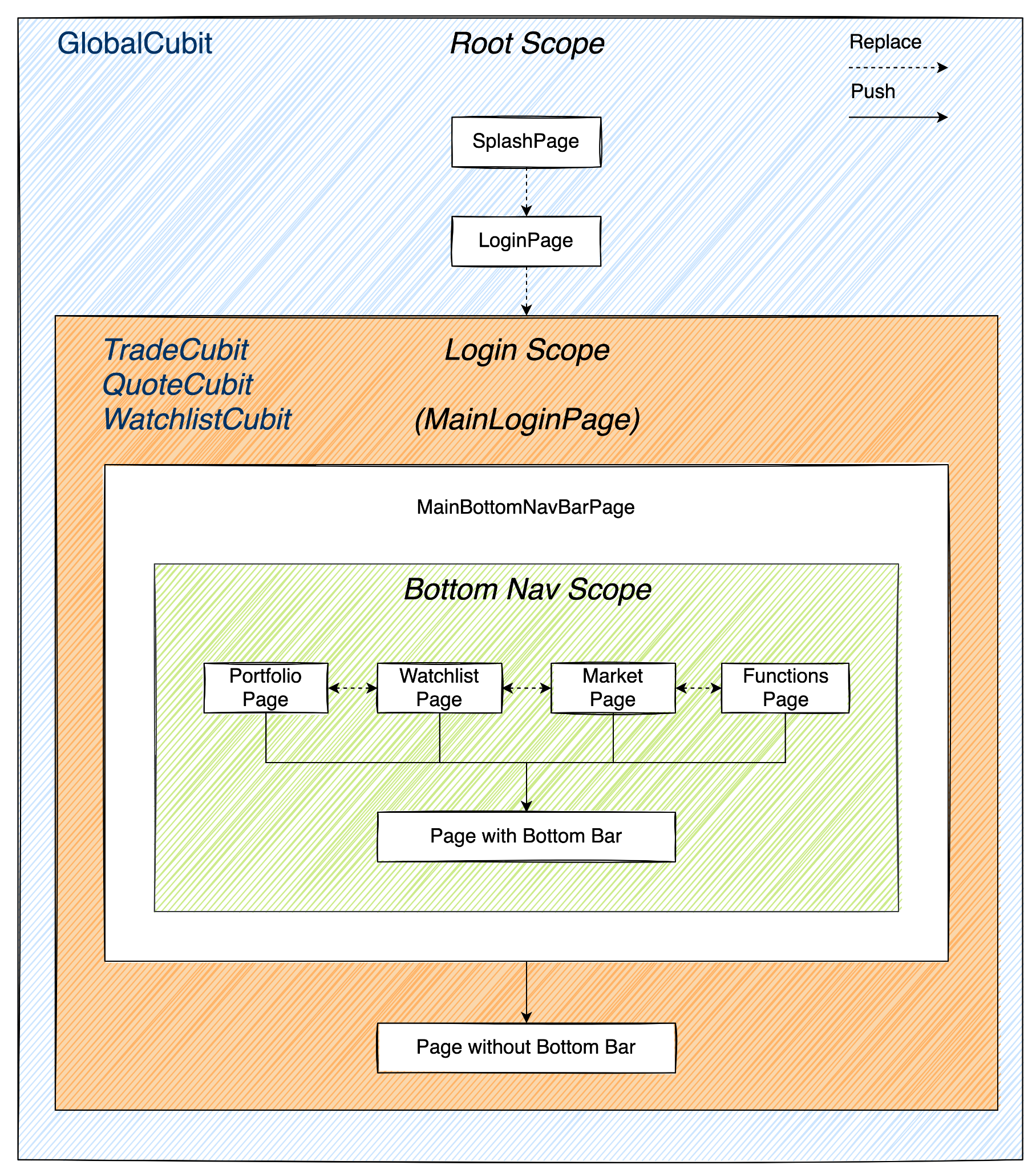
Navigation
Scope

Slide 15
END

